Slide 1

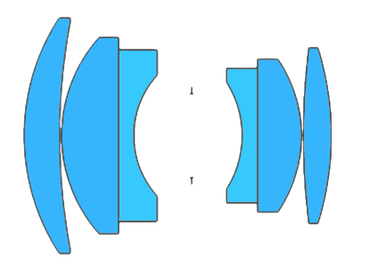

Omnifocus image synthesis using lens swivel
Control Number: 2512962
Indranil Sinharoy Prasanna Rangarajan Marc P. Christensen
Lyle School of Engineering, SMU, Dallas, TX, USA.
Photonics Architecture Lab, SMU
Imaging and Applied Optics Congress 2016
Notes:
In this paper we discuss a method to synthesize an all-in-focus image by combining multiple images captured while rotating a lens.

Slide 2
Problem

Slide 3
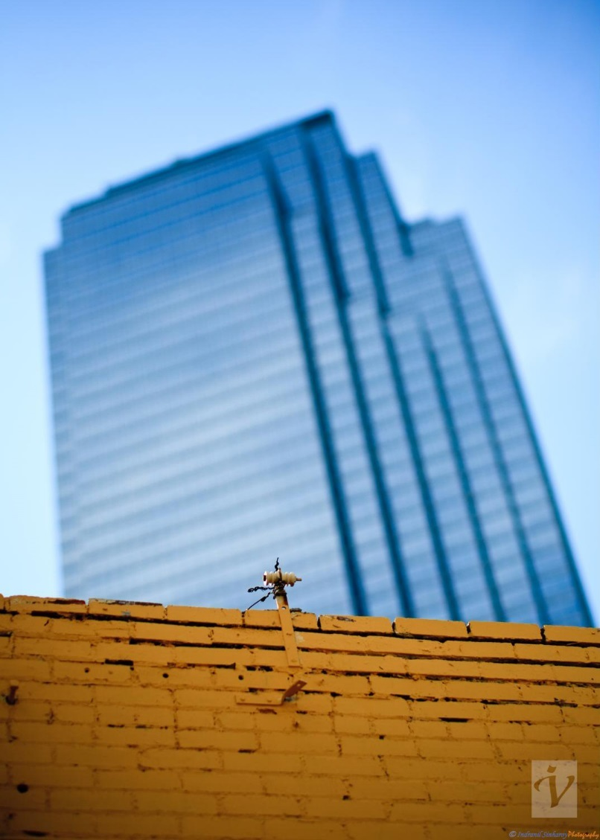
Cameras have limited Depth Of Field (DOF)
A lens cannot focus at multiple depths at a time causing parts of the image to appear blurry.
Notes:
It is a common experience that a lens cannot focus at multiple depths at a time, causing parts of the image to appear blurry.

Slide 4
Two existing methods to extend DOF
Notes:
The technique presented here combines two existing methods which are briefly discussed next.

Slide 5
Focus stacking concept
DEEP OBJECT SPACE
Sensor
Multiple photographs are captured at different focus depths.
Multiple photographs are captured at different focus depths.
The images in the stack collectively contains all regions of the scene in focus.
Multiple photographs are captured at different focus depths.
The images in the stack collectively contains all regions of the scene in focus.
An all-in-focus image is synthesized by selectively blending the sharply focused regions across the images in the stack.
Notes:
In the first method, known as focus stacking, multiple photographs are captured at different focus depths. While no individual photograph contains the entire object space in focus, regions at different depths form sharp images in one or more photographs in the stack.
An all-in-focus image is generated by selectively blending the in-focus regions.
Variance in focal depth can be achieved either by changing the focal length or by varying the sensor plane distance as shown.

Slide 6
Focus stacking concept
Depth of Field
DEEP OBJECT SPACE
Sensor
Plane of sharp focus

Slide 7
Focus stacking concept
Depth of Field
DEEP OBJECT SPACE
Sensor
Plane of sharp focus

Slide 8
Focus stacking concept
Depth of Field
DEEP OBJECT SPACE
Sensor
Plane of sharp focus

Slide 9
Focus stacking concept
Depth of Field
DEEP OBJECT SPACE
Sensor
Plane of sharp focus

Slide 10
Focus stacking concept
Depth of Field
DEEP OBJECT SPACE
Sensor
Plane of sharp focus
Notes:
The plane of sharp focus is plane-parallel with the lens and sensor planes. Therefore, they intersect at infinity.

Slide 11
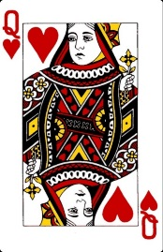
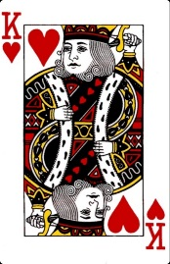
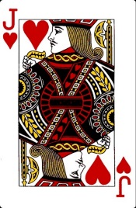

Focus stacking example
Lens
64 mm
Sensor plane
$z$-axis
89 mm
200 mm
200 mm
1000 mm
Scene with three playing cards frontoparallel with the camera.
Notes:
As an example, consider a scene containing three playing cards at three different depths.

Slide 12
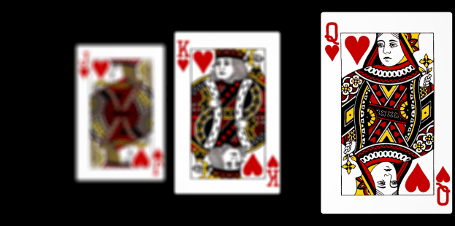
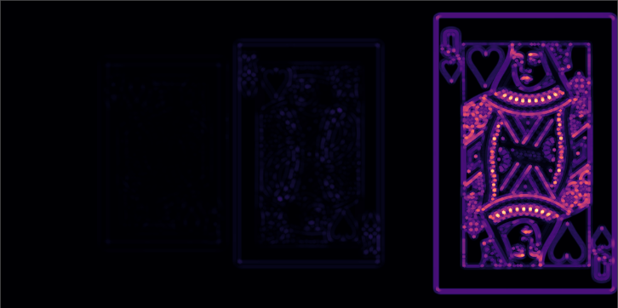
Focus stacking example
Sensor image 1/3
Lens
64 mm
Sensor plane
$z$-axis
89 mm
200 mm
Focus measure (LoG)
200 mm
1000 mm
Front card is in focus. In-focus regions are detected using a Laplacian of Gaussian filter.
Notes:
First, only the front card is in focus. The in-focus regions are detected using a Laplacian of Gaussian operator.

Slide 13
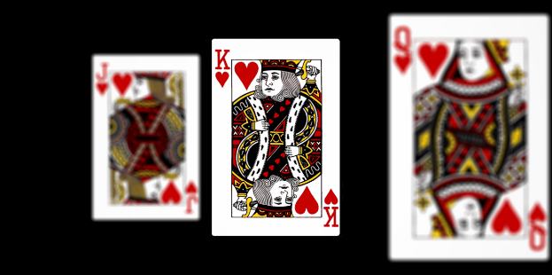
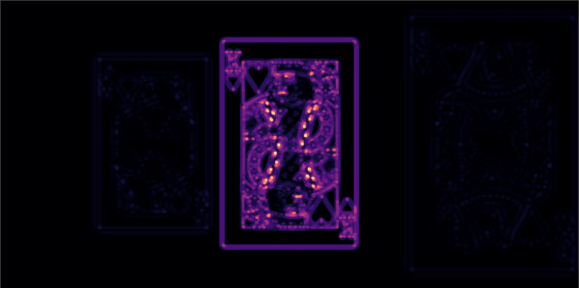
Focus stacking example
Sensor image 2/3
Lens
64 mm
Sensor plane
$z$-axis
89 mm
200 mm
Focus measure (LoG)
200 mm
1000 mm
In the second image the lens is focused on the middle card.
Notes:
The second image is captured while focusing on the middle card.

Slide 14

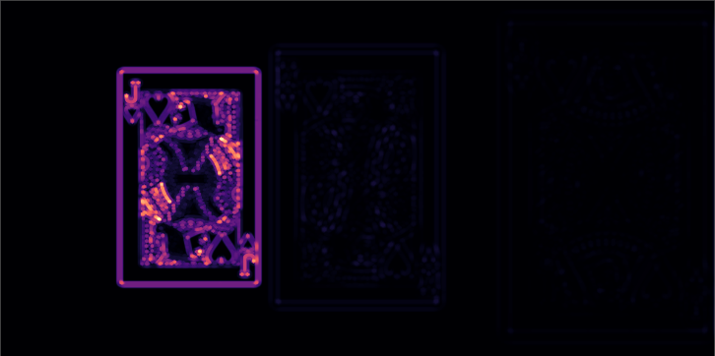
Focus stacking example
Sensor image 3/3
Lens
64 mm
Sensor plane
$z$-axis
89 mm
200 mm
Focus measure (LoG)
200 mm
1000 mm
Finally, an image with the rear card in focus is captured.
Notes:
Finally, an image with the rear card in focus is captured.

Slide 15
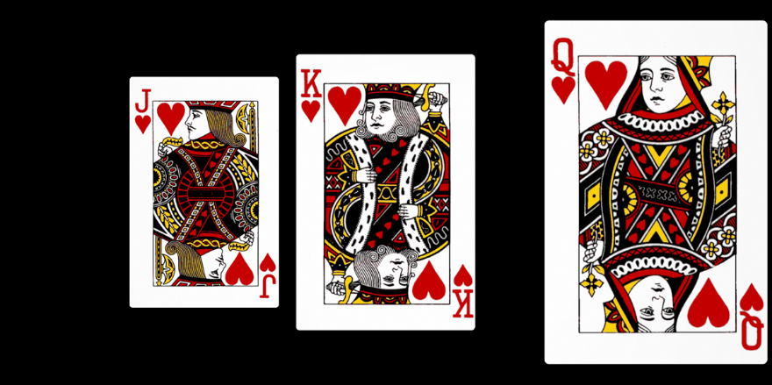
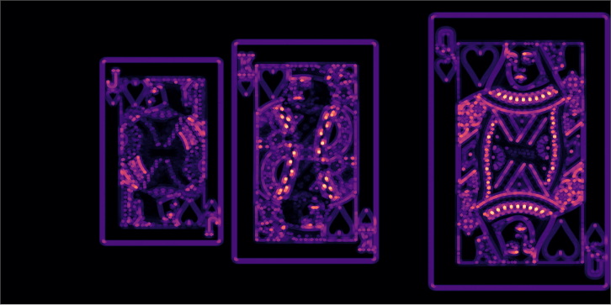
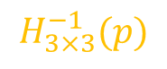
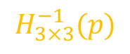
Focus stacking example
Registration
Blending
Composite image
1/2
Images have different magnifications.
$$H_{3×3}^{−1}(p)$$
1/2
$$H_{3×3}^{−1}(p)$$
Focus measure (LoG)
Notes:
The individual images in the stack have varying magnifications. They are first registered and then blended to synthesize an all-in-focus image.

Slide 16
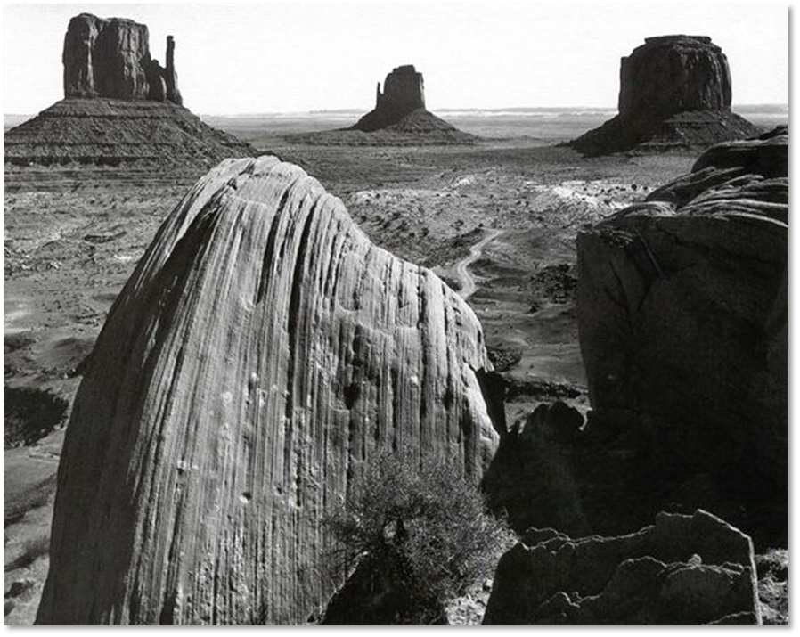
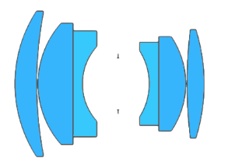
Scheimpflug imaging
Plane of sharp focus
Lens plane
Image plane
Ansel Adams, Collection Center for Creative Photography, University of Arizona, © 2016
Scheimpflug line
Notes:
In the second method called Scheimpflug imaging, the lens is rotated about a pivot inducing a rotation of the plane of sharp focus.
Using appropriate tilts, the plane of sharp focus can be aligned to bring portions of the foreground and background in focus.

Slide 17
Proposed method

Slide 18
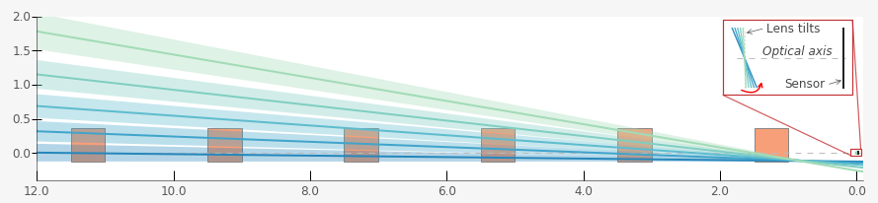
Illustration of idea
DEEP OBJECT SPACE
Sensor
We tilt the lens about the entrance pupil while capturing images of the scene.
Notes:
In our method, we tilt the lens about the entrance pupil while capturing images of the scene.

Slide 19
Illustration of idea
Plane of sharp focus
DEEP OBJECT SPACE
Sensor
The plane of sharp focus and the wedge shaped depth of field sweeps through the scene forming regions in sharp focus across the images in the stack.

Slide 20
Illustration of idea
Plane of sharp focus
DEEP OBJECT SPACE
Sensor
The plane of sharp focus and the wedge shaped depth of field sweeps through the scene forming regions in sharp focus across the images in the stack.

Slide 21
Illustration of idea
Plane of sharp focus
DEEP OBJECT SPACE
Sensor
The plane of sharp focus and the wedge shaped depth of field sweeps through the scene forming regions in sharp focus across the images in the stack.

Slide 22
Illustration of idea
Plane of sharp focus
DEEP OBJECT SPACE
Sensor
The plane of sharp focus and the wedge shaped depth of field sweeps through the scene forming regions in sharp focus across the images in the stack.

Slide 23
Illustration of idea
Plane of sharp focus
DEEP OBJECT SPACE
DEEP OBJECT SPACE
Sensor
The plane of sharp focus and the wedge shaped depth of field sweeps through the scene forming regions in sharp focus across the images in the stack. These in-focus regions can be selectively blended.
Notes:
The plane of sharp focus and the wedge-shaped depth of field region sweeps through the scene forming regions in sharp focus across the images in the stack. These in-focus regions can be selectively blended as discussed previously.

Slide 24
Simulation

Slide 25
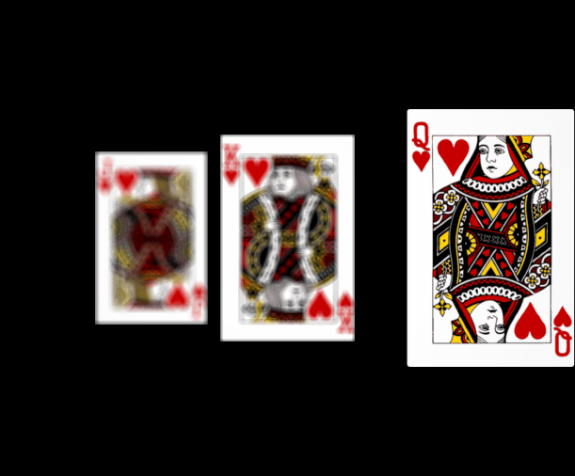
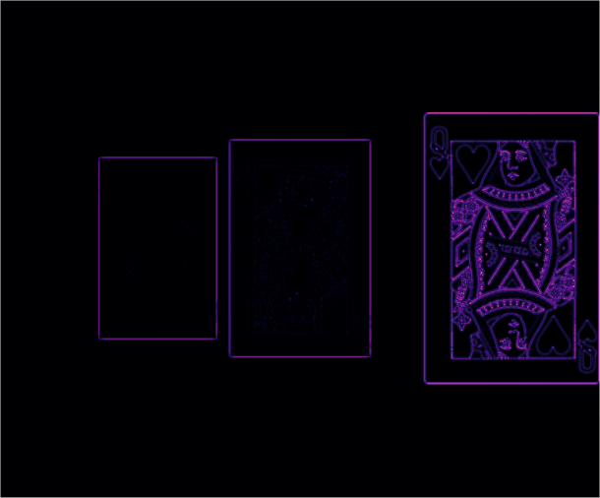
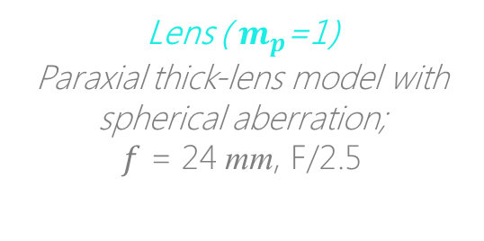
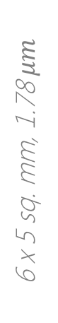
Simulation
Setup in Zemax
Sensor image 1/13 ( 0°)
Lens ( $m_{p}$=1)
Paraxial thick-lens model with spherical aberration;
$f$ = 24 mm, F/2.5
1/2
64 mm
$z$-axis
Sensor plane
6 x 5 sq. mm, 1.78 $μm$
89 mm
13 tilts
between -8° & +8°
200 mm
1/2
200 mm
1000 mm
Focus measure (LoG)
A $f=24$ mm symmetric lens is rotated about the ENPP.
Notes:
Here is Zemax based proof of concept simulation of our method, in which we rotate a 24 mm symmetric lens about its entrance pupil.

Slide 26
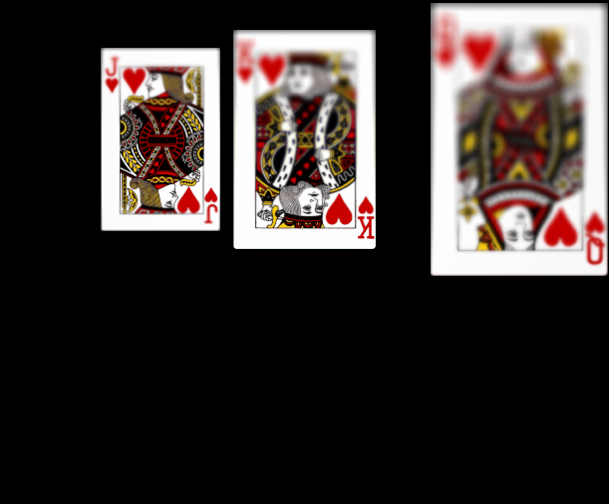
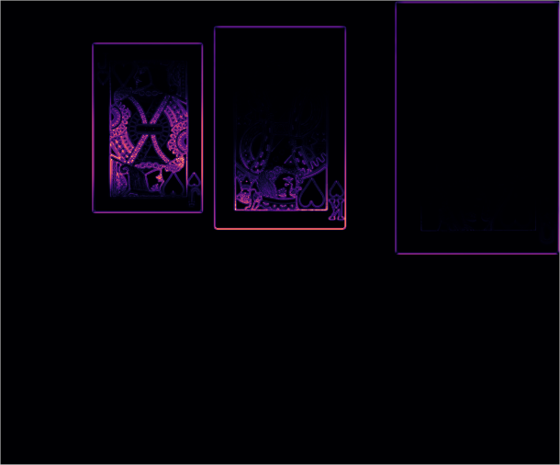

Simulation
Lens rotated by -$α$° about ENPP
Sensor image 7/13 (-8°)
Lens ( $m_{p}$=1)
Paraxial thick-lens model with spherical aberration;
$f$ = 24 mm, F/2.5
1/2
64 mm
$z$-axis
Sensor plane
6 x 5 sq. mm, 1.78 $μm$
89 mm
13 tilts
between -8° & +8°
200 mm
1/2
200 mm
1000 mm
The image contains portions of all three cards in focus.
There is a transverse shift in the image field.
Focus measure (LoG)
Notes:
On top right is the image of the scene captured under lens tilt. It contains portions of all three cards in focus. Also, there is a transverse shift of the image field.

Slide 27
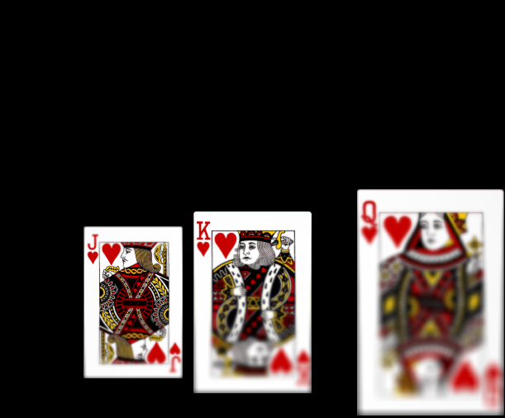
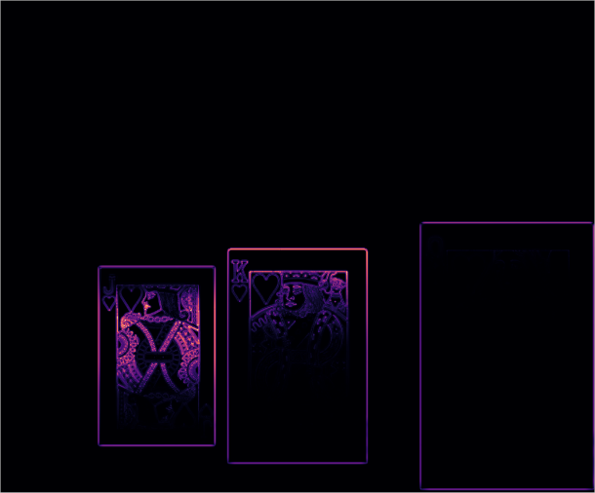

Simulation
Lens rotated by $α$° about ENPP
Sensor image 13/13 (8°)
Lens ( $m_{p}$=1)
Paraxial thick-lens model with spherical aberration;
$f$ = 24 mm, F/2.5
1/2
64 mm
$z$-axis
Sensor plane
6 x 5 sq. mm, 1.78 $μm$
89 mm
13 tilts
between -8° & +8°
200 mm
1/2
200 mm
1000 mm
Focus measure (LoG)
Notes:
The lens is tilted in both clockwise and anticlockwise directions.

Slide 28
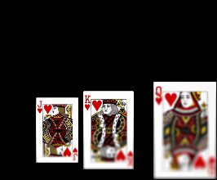
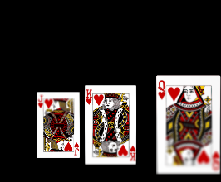
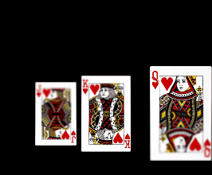
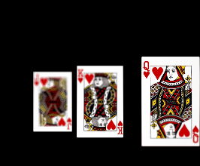
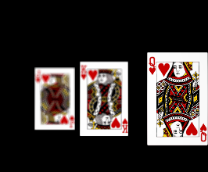
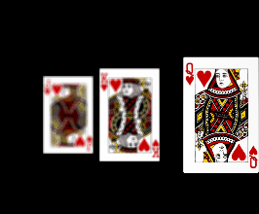
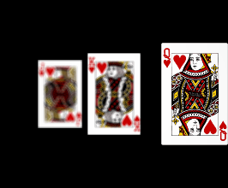
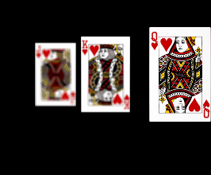
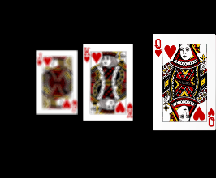
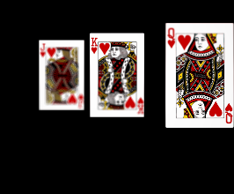
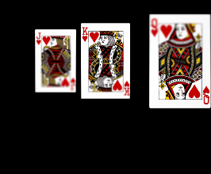
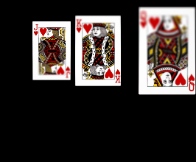

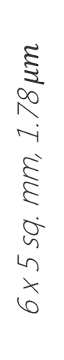

Simulation
Image stack
Lens ( $m_{p}$=1)
64 mm
$z$-axis
Sensor plane
6 x 5 sq. mm, 1.78 $μm$
89 mm
13 tilts
between -8° & +8°
200 mm
200 mm
1000 mm
Notes:
The stack contains 13 images obtained under uniform tilts of the lens between plus minus eight degrees.

Slide 29

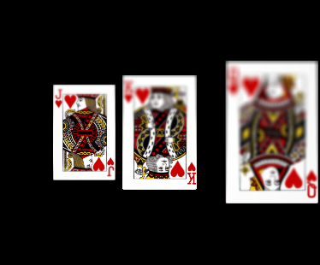
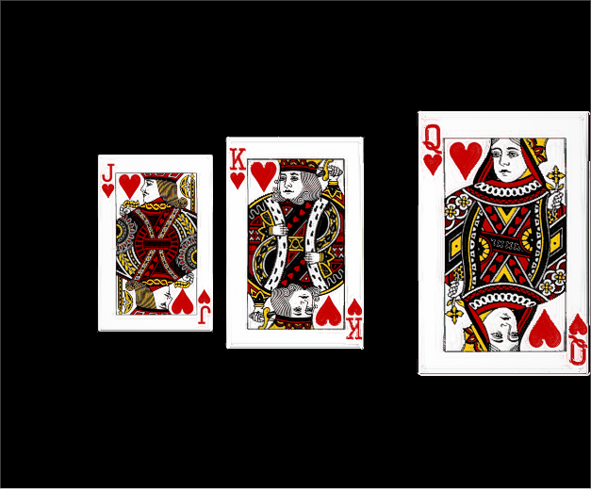
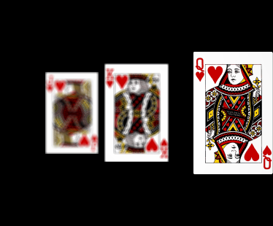
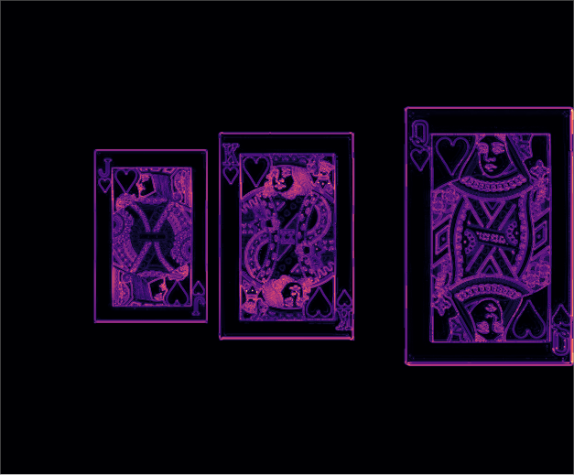

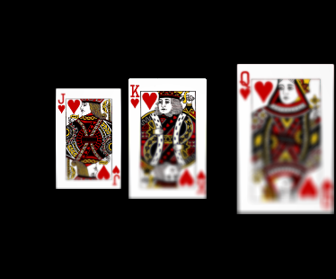




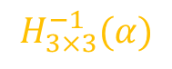
Simulation
Registration
Blending
Composite image
$$H_{3×3}^{−1}(α)$$
1/2
$$⋮$$
$$⋮$$
Focus measure (LoG)
$$⋮$$
$$⋮$$
1/2
$$H_{3×3}^{−1}(α)$$
Notes:
Based on our model of Scheimpflug imaging, we have derived a closed form expression of the inter-image homography that is used to register the images in the stack. Following registration, we create a composite image that contains all portions of the scene in focus.

Slide 30
Advantages and comparison
Simple if the pupil magnification of the lens is one.
Can be used to improve the depth of field of Scheimpflug cameras.
Notes:
Our method is simple and it can used to extend the depth of field of scheimpflug cameras.

Slide 31

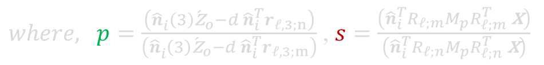
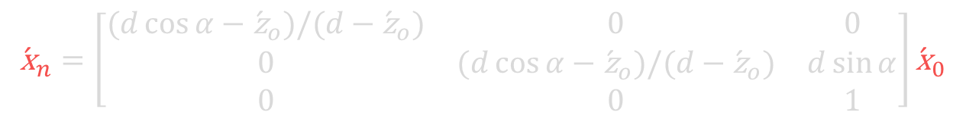
Model
Geometric relation of world point and image point
$$\begin{aligned}{}_{ }^{I}{\acute{\text{x}}}=&{R_{i}^{T}}^{ }\left({\acute{d}}_{e} r_{𝓁,3}−t_{i}\right)&+\frac{\left({\hat{n}}_{i}\left(3\right){\acute{z}}_{o}−{\acute{d}}_{e}{\hat{n}}_{i}^{T} r_{𝓁,3}\right)}{{\hat{n}}_{i}^{T}{}_{ }^{ }{R_{𝓁}}M_{p}{R_{𝓁}^{T}}^{ }\left({}_{ }^{c}{\text{x}}−d_{e} r_{𝓁,3}\right)}{}_{ }^{ }{{R_{i}^{T}}^{ }R_{𝓁}}M_{p}{R_{𝓁}^{T}}^{ }\left({}_{ }^{c}{\text{x}}−d_{e} r_{𝓁,3}\right) \\ \end{aligned}$$
Inter-image homography under lens tilts about the entrance pupil
$$\begin{aligned}{\acute{\text{x}}}_{n}=&\left[\begin{aligned}&{}_{ }^{ }{p s R_{𝓁;n}}M_{p}{R_{𝓁;n}^{T}}^{ }{}_{ }^{ }{R_{𝓁;m}}M_{p}^{−1}{R_{𝓁;m}^{T}}^{ }+\frac{d}{{\hat{n}}_{i}^{ }(3){\acute{\text{z}}}_{o}}\left(r_{𝓁,3;n}−{}_{ }^{ }{p s R_{𝓁;n}}M_{p}{R_{𝓁;n}^{T}}^{ }{}_{ }^{ }{R_{𝓁;m}}M_{p}^{−1}{R_{𝓁;m}^{T}}^{ }\right){\hat{n}}_{i}^{T} \\ & \end{aligned}\right]{\acute{\text{x}}}_{m} \\ & \end{aligned}$$
$where, p=\frac{\left({\hat{n}}_{i}^{ }\left(3\right){\acute{\text{z}}}_{o}−d{ \hat{n}}_{i}^{T}r_{𝓁,3;n}\right)}{\left({\hat{n}}_{i}^{ }\left(3\right){\acute{\text{z}}}_{o}−d{ \hat{n}}_{i}^{T}r_{𝓁,3;m}\right)}$ , $s=\frac{\left({\hat{n}}_{i}^{T}R_{𝓁;m}M_{p}{R_{𝓁;m}^{T}}^{ }\text{x}\right)}{\left({\hat{n}}_{i}^{T}R_{𝓁;n}M_{p}{R_{𝓁;n}^{T}}^{ }\text{x}\right)}$
If pupil magnification, $m_{p}=1$, the inter-image homography reduces to
$$\begin{aligned}{\acute{\text{x}}}_{n}=\left[\begin{matrix}(d\cos{α}−{\acute{\text{z}}}_{o})/(d−{\acute{\text{z}}}_{o}) & 0 & 0 \\ 0 & (d\cos{α}−{\acute{\text{z}}}_{o})/(d−{\acute{\text{z}}}_{o}) & d\sin{α} \\ 0 & 0 & 1\end{matrix}\right]{\acute{\text{x}}}_{0} \\ & \end{aligned}$$
Notes:
While the notion of creating an all-in-focus image from multiple images under lens tilts is straightforward, our model allowed us to find the appropriate conditions under which such a method can be realized in practice. Please visit our poster for details.

Slide 32





Additional information
For more details (including reproducible code) please visit
indranilsinharoy.com/projects/omnifocus
Open source tools used for numerical computations and plotting:
PyZDDE (Python Zemax DDE toolbox).
Python Scientific libraries – NumPy, Jupyter, Matplotlib & h5py.
Photonics Architecture Lab, SMU, USA.
Imaging and Applied Optics Congress 2016
Notes:
Also refer to the link shown for additional information on the method. The IPython computational notebooks containing the Zemax simulations are also available.

